Slide 1
Virtualization
Manoj (maNu)

Slide 2
What is Virtualization
Virtualization is technology that you can use to create virtual representations of servers, storage, networks, and other physical machines. Virtual software mimics the functions of physical hardware to run multiple virtual machines simultaneously on a single physical machine.
Businesses use virtualization to use their hardware resources efficiently and get greater returns from their investment.
Virtualization is a powerful technology within IT infrastructure that can be used to increase efficiency, retain flexibility, and improve scalability. Because multiple operating systems can share the same physical hardware.
Virtualization can improve resource use, reduce costs associated with physical maintenance, and boost security through isolated systems.
Notes:
Used for decades, virtualization is a powerful technology within IT infrastructure that can be used to increase efficiency, retain flexibility, and improve scalability. Because multiple operating systems can share the same physical hardware, virtualization can improve resource use, reduce costs associated with physical maintenance, and boost security through isolated systems.

Slide 3
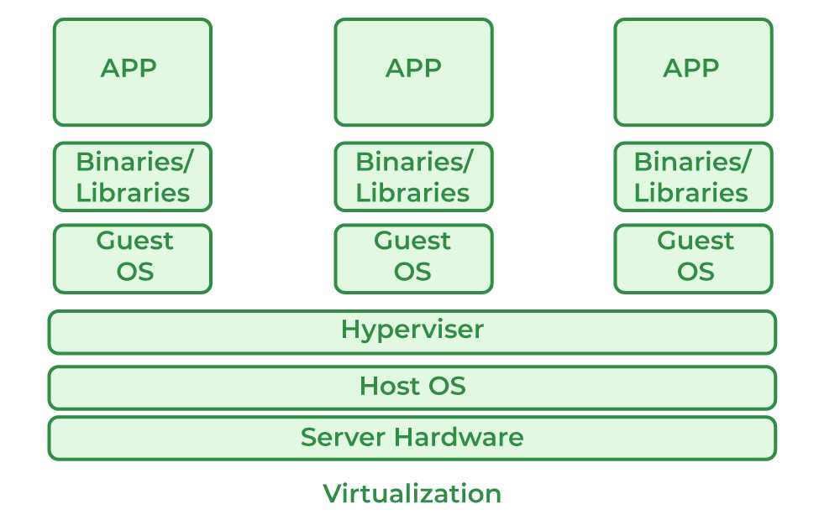
Virtualization……….
The term virtualization is often synonymous with hardware virtualization, which plays a fundamental role in efficiently delivering Infrastructure-as-a-Service (IaaS) solutions for cloud computing. Moreover, virtualization technologies provide a virtual environment for not only executing applications but also for storage, memory, and networking
Host Machine: The machine on which the virtual machine is going to be built is known as Host Machine.
Guest Machine: The virtual machine is referred to as a Guest Machine.
Notes:
There is misconceptualization of virtualization in the real world people think virtualization == hardware virtualization which is in correct.

Slide 4
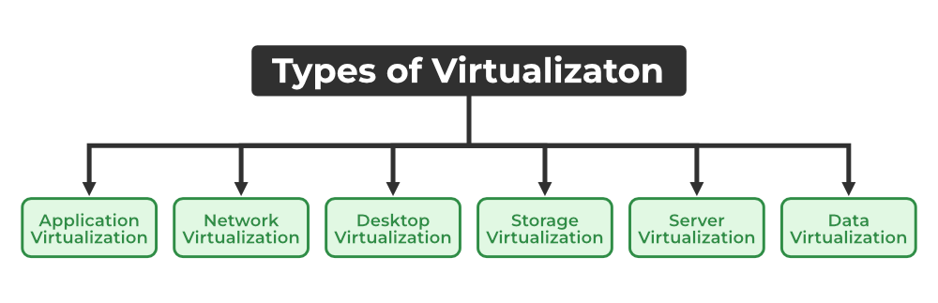
Types of Virtualization
Notes:
Application Virtualization: This lets you use an application on your local device while it’s actually hosted on a remote server. Your personal data and the app’s settings are stored on the server, but you can still run it locally via the internet.
Network Virtualization: This allows multiple virtual networks to run on the same physical network, each operating independently. You can quickly set up virtual switches, routers, firewalls, and VPNs, making network management more flexible and efficient.
Desktop Virtualization: With desktop virtualization, your operating system is stored on a server and can be accessed from anywhere on any device. It’s great for users who need flexibility, as it simplifies software updates and provides portability.
Storage Virtualization: This combines storage from different servers into a single system, making it easier to manage. It ensures smooth performance and efficient operations even when the underlying hardware changes or fails.
Server Virtualization: This splits a physical server into multiple virtual servers, each functioning independently. It helps improve performance, cut costs and makes tasks like server migration and energy management easier.
Data Virtualization: This brings data from different sources together in one place without needing to know where or how it’s stored. It creates a unified view of the data, which can be accessed remotely via cloud services.

Slide 5
How Does Virtualization work
Virtual machines
A virtual machine (VM) is a computing environment that functions as an isolated system with its own CPU, operating system (OS), memory, network interface, and storage, created from a pool of hardware resources.
As an isolated environment, it can be moved from 1 computer to another, opened in either, and be expected to work the same.
Virtualization allows virtual machines with multiple different operating systems to run simultaneously on a single physical device—like running a MacOS or Linux environment on a Windows base system
Each operating system runs in the same way an OS or application normally would on the host hardware, so the end user’s experience is nearly identical to a real-time operating system experience running on a physical machine.
Notes:
Virtualization depends on 2 important concepts: virtual machines and hypervisors.

Slide 6
Hypervisors (Sometimes called a virtual machine monitor (VMM))
A hypervisor is software that separates a system’s physical resources and divides those resources so that virtual environments can use them as needed.
A hypervisor takes physical resources (such as CPU, memory, and storage) from the hardware and allocates them to multiple VMs at once, enabling the creation of new VMs and the management of existing ones.
Hypervisors can sit on top of an operating system (like on a laptop) or be installed directly onto hardware (like a server).
The physical hardware, when used as a hypervisor, is called the host, while the many VMs that use its resources are guests.

Slide 7
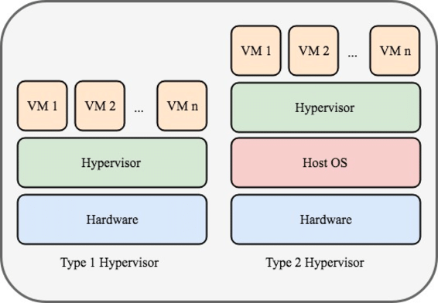
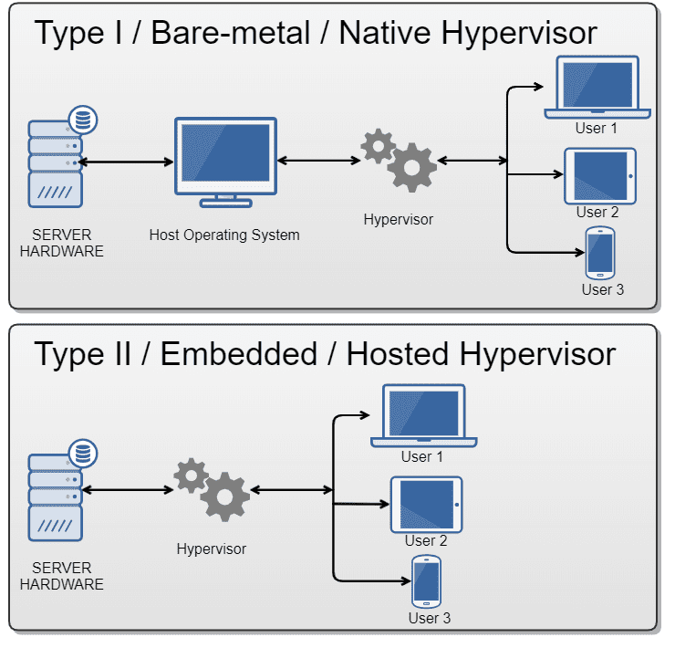
Types of Hypervisor
Type 1: Also referred to as a native or bare-metal hypervisor, it runs directly on the host’s hardware to manage guest operating systems. It takes the place of a host operating system, and VM resources are scheduled directly to the hardware by the hypervisor. This type of hypervisor is most common in an enterprise datacenter or other server-based environments.
VMware ESXi, Microsoft Hyper-V, KVM
Type 2: Also known as a hosted hypervisor, it runs on a conventional operating system as a software layer or application. It works by abstracting guest operating systems from the host operating system. VM resources are scheduled against a host operating system, which is then executed against the hardware. This type is better for individual users who want to run multiple operating systems on a personal computer
Oracle VM VirtualBox, VMware Workstation, Citrix Hypervisor
Notes:
There are 2 different types of hypervisors that allow virtualization to happen based on need.
Hypervisor in AWS Nitro Hypervisor:
This is a type-1 hypervisor, also known as a bare-metal hypervisor, meaning it's installed directly on the physical server's hardware.

Slide 8
Why we need Virtualization Use of Virtualization
Resource Optimization.
Cost Efficiency.
Isolation and Security.
Flexibility and Scalability.
Disaster Recovery.
Testing and Development.
Notes:
Resource Optimization: Virtualization allows multiple virtual machines (VMs) to run on a single physical server, maximizing the use of available resources (CPU, memory, storage).
Cost Efficiency: By consolidating workloads onto fewer physical machines, organizations can reduce hardware costs, energy consumption, and maintenance overhead.
Isolation and Security: Virtual machines are isolated from each other, ensuring that issues in one VM (like security breaches or software crashes) do not affect others.
Flexibility and Scalability: Virtualization makes it easy to create, clone, or move virtual machines, allowing businesses to scale resources up or down based on demand.
Disaster Recovery: VMs can be easily backed up and restored, enabling faster recovery from hardware failures or data loss compared to traditional physical systems.
Testing and Development: Virtualization enables the creation of test environments, allowing developers to simulate different operating systems and configurations without needing dedicated hardware for each scenario.

Slide 9
Cons of Virtualization
High Initial Investment.
Complexity.
Security Risks.
Learning New Infrastructure.
Data can be at Risk.
Notes:
High Initial Investment: While virtualization reduces costs in the long run, the initial setup costs for storage and servers can be higher than a traditional setup.
Complexity: Managing virtualized environments can be complex, especially as the number of VMs increases.
Security Risks: Virtualization introduces additional layers, which may pose security risks if not properly configured and monitored.
Learning New Infrastructure: As Organization shifted from Servers to Cloud. They required skilled staff who can work with cloud easily. Either they hire new IT staff with relevant skill or provide training on that skill which increase the cost of company.
Data can be at Risk: Working on virtual instances on shared resources means that our data is hosted on third party resource which put’s our data in vulnerable condition. Any hacker can attack on our data or try to perform unauthorized access. Without Security solution our data is in threaten situation.

Slide 10
Self Study
Practical on type 2 hypervisor.
Practical on type 1 hypervisor.
Make self notes on these concepts.
Deep dive into types of virtualization.
Virtualization vs cloud computing.
Migration of VMs what why and how.
How server virtualization different from containerization (future).
20-25 unique QnA related to Virtualization.

